Slide 1
19CSE202 DATABASE MANAGEMENT SYSTEMS (DBMS)
Introduction To Relational Model
session 1
Dr. Sikha O K
Assistant Professor(Sr.Gr)
Computer Science and Engineering Dept
ASE-Coimbatore

Slide 2
TOPICS
Introduction to RDBMS & Relational Model
Relations
Schema
Attributes
Keys
Referential Integrity
Schema Diagram
Relational Query Languages

Slide 3

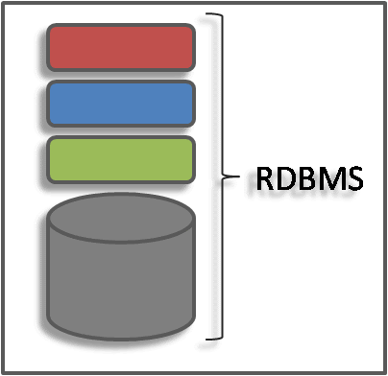
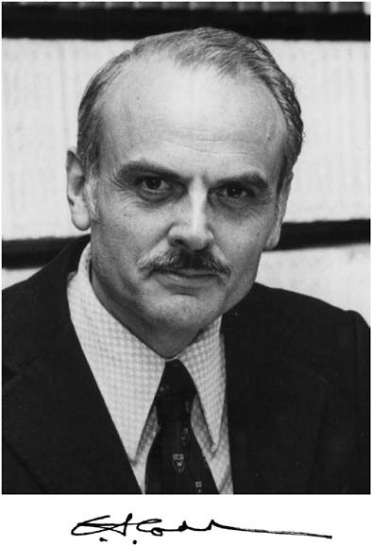
Relational Database Model
Most Common model in industry
Based on the relational model developed by E.F.Codd
Data and relations between them are organized as tables

Slide 4
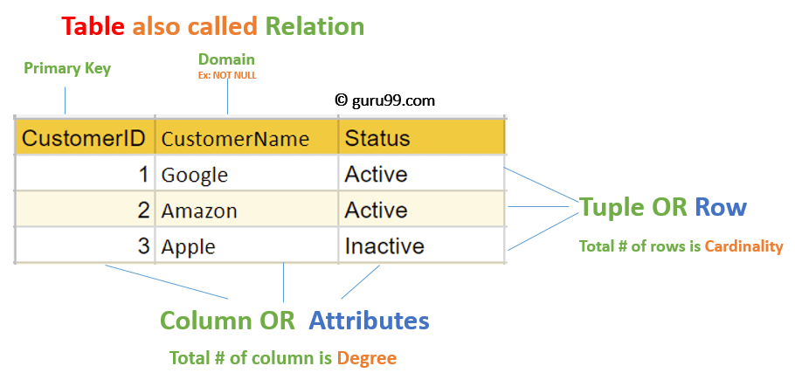
Relational Database Model
Data is presented as a collection of relations.
Each relation is depicted as a table.
Columns are attributes.
Each row represents an entity.

Slide 5
Relations
A relation is a two-dimensional table:
Relation ≈ table.
Attribute ≈ column name.
Tuple ≈ row (not the header row).
Database ≈ collection of relations.
A relation has two parts:
Schema defines column heads of the table (attributes).
Instance contains the data rows (tuples, rows, or records) of the table.
Student_name | Course | Grade
Hermione Grainger | Potions | A-
Draco Malfoy | Potions | B
Harry Potter | Potions | A
Ron Weasley | Potions | C

Slide 6
Schema
SCHEMA describes the relation name (table name), attributes, and their names.
CoursesTaken(Student, Course, Grade)
A design in a relational model consists of a set of schemas.
Such a set of schemas is called a relational database schema.
CoursesTaken :
Student_name | Course | Grade
Hermione Grainger | Potions | A-
Draco Malfoy | Potions | B
Harry Potter | Potions | A
Ron Weasley | Potions | C

Slide 7
Degree and Cardinality
CoursesTaken :
Degree is the number of fields/attributes in schema (=3 in the table above)
Cardinality is the number of tuples in relation (=4 in the table above)
1
2
3
Student_name | Course | Grade
Hermione Grainger | Potions | A-
Draco Malfoy | Potions | B
Harry Potter | Potions | A
Ron Weasley | Potions | C
1
2
3
4

Slide 8
Relational Database Model Basic Concepts: In Short
Relation Instance: A finite set of tuples in the relational database system represents relation instance. Relation instances do not have duplicate tuples.
Relation schema : A relation schema describes the relation name (table name), attributes, and their names.
Degree : of a relation is the number of attribute of its relation schema
Cardinality : of a relation is the number of tuples.

Slide 9
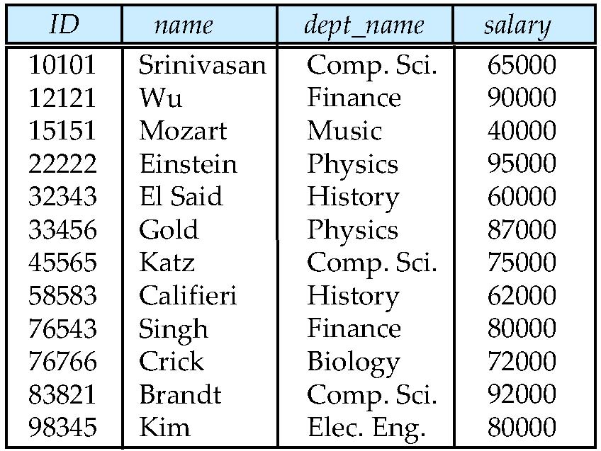
INSTRUCTOR
Write down the Schema
INSTRUCTOR(ID,name,dept_name,salray)

Slide 10
INSTRUCTOR
What is the degree and cardinality
Degree= 4
Cardinality= 12

Slide 11
Attribute Types
The set of allowed values for each attribute is called the domain of the attribute
Atomic Attribute
Composite Attribute
Single Valued Attribute
Multivalued Attribute
Stored Attribute
Derived Attribute
Null Valued Attribute
Key Attribute

Slide 12
Attribute Types
An attribute that cannot be divided into smaller independent attribute is known as atomic attribute.
Customer
Cust_Name | Cust_ID | Gender | DOB | Door_no | Phone_no

Slide 13
Attribute Types
An attribute that can be divided into smaller independent attribute is known as composite attribute.
Customer
Cust_Name | Cust_ID | Gender | DOB | Door_no | Phone_no
F_Name
M_Name
L_Name

Slide 14
Attribute Types
An attribute that has only single value for an entity is known as single valued attribute.
An attribute that can have multiple values for an entity is known as multi valued attribute.
Customer
Cust_Name | Cust_ID | Gender | DOB | Door_no | Phone_no

Slide 15
Attribute Types
An attribute that cannot be derived from another attribute is known as stored attribute.
An attribute that can be derived from another attribute is known as derived attribute.
Customer
Cust_Name | Cust_ID | Gender | DOB | Door_no | Phone_no
AGE

Slide 16
Attribute Types
An attribute, which has not any value for an entity is known as null valued attribute.
An attribute that has unique value of each entity is known as key attribute.
Customer
Cust_Name | Cust_ID | Gender | DOB | Door_no | Phone_no

Slide 17
Attribute Types
Student
Identify Atomic, Composite, single valued ,multi valued, null valued and key attributes
ID | Student name | Course | Grade | Address | Phone_number
1 | Hermione Grainger | Potions | A+ | House no 5, Little Whinging, Surrey | 9191819191 7877878778
2 | Draco Malfoy | Potions | B | House no 10, Little Whinging, Surrey | 2347879980
3 | Harry Potter | Potions | A | House no 4, Privet Drive, Little Whinging, Surrey | 1234567890
4 | Ron Weasley | Potions | C | House no 12, Little Whinging, Surrey | 5689745623

Slide 18
KEYS
A data item [attribute] which can uniquely identify a tuple in a relation.
SUPER KEY
CANDIDATE KEY
PRIMARY KEY
SUPER KEY
Any combination of attributes which can uniquely identify a tuple
Super Key={S_roll} , {s_name,S_roll}
Student
s_name | S_roll
ram | 123
sanjay | 124
manju | 125
meenu | 126
ram | 127

Slide 19
Identify super keys for the following table
Book
book_id | name | author
B1 | XYZ | A1
B2 | ABC | A1
B3 | XYZ | A2
B4 | PQR | A3
B5 | LSP | A1
SK={ book_id} , {book_id,name}, {name,author}, {book_id,name,author}
Super key will be redundant

Slide 20
Candidate key
A super key without redundancy
Candidate key may have multiple attributes
Not reducible
Minimal super key
Book
book_id | name | author
B1 | XYZ | A1
B2 | ABC | A1
B3 | XYZ | A2
B4 | PQR | A3
B5 | LSP | A1
{ book_id}
{book_id,name}
{name,author}
{book_id,name,author}

Slide 21
KEYS
Employee
Emp_Id | Emp_Number | Emp_Name
E01 | 2264 | Steve
E22 | 2278 | Ajeet
E23 | 2288 | Chaitanya
E45 | 2290 | Robert
How many super keys the above table can have?
1. {Emp_Id} 2. {Emp_Number} 3. {Emp_Id, Emp_Number} 4. {Emp_Id, Emp_Name} 5. {Emp_Id, Emp_Number, Emp_Name} 6. {Emp_Number, Emp_Name}

Slide 22
KEYS
Employee
Emp_Id | Emp_Number | Emp_Name
E01 | 2264 | Steve
E22 | 2278 | Ajeet
E23 | 2288 | Chaitanya
E45 | 2290 | Robert
How many candidate keys the above table can have?
{Emp_Id} ----No redundant attributes
{Emp_Number} ---- No redundant attributes
{Emp_Id, Emp_Number}--- Redundant attribute.
{Emp_Id, Emp_Name}--- Redundant attribute Emp_Name.
{Emp_Id, Emp_Number, Emp_Name} Redundant attributes. Emp_Id or Emp_Number alone are sufficient
{Emp_Number, Emp_Name} --- Redundant attribute Emp_Name.

Slide 23
KEYS
Employee
Emp_Id | Emp_Number | Emp_Name
E01 | 2264 | Steve
E22 | 2278 | Ajeet
E23 | 2288 | Chaitanya
E45 | 2290 | Robert
How many candidate keys the above table can have?
{Emp_Id} ----No redundant attributes
{Emp_Number} ---- No redundant attributes
{Emp_Id, Emp_Number}--- Redundant attribute.
{Emp_Id, Emp_Name}--- Redundant attribute Emp_Name.
{Emp_Id, Emp_Number, Emp_Name} Redundant attributes. Emp_Id or Emp_Number alone are sufficient
{Emp_Number, Emp_Name} --- Redundant attribute Emp_Name.

Slide 24
Primary key
Book
One of the candidate key
Composite/Atomic
How will you select a primary key ?
book_id | name | author
B1 | XYZ | A1
B2 | ABC | A1
B3 | XYZ | A2
B4 | PQR | A3
B5 | LSP | A1
{ book_id}
{name,author}

Slide 25
KEYS
SUPER KEY
CANDIDATE KEY
PRIMARY KEY

Slide 26
Is everything fine here?
Department
Employee
DeptCode | DeptName
001 | Science
002 | English
005 | Computer
Teacher ID | Fname | Lname
B002 | David | Warner
B017 | Sara | Joseph
B009 | Mike | Brunton
HOW DO YOU GET THE DEAPARTMENT NAME OF A TEACHER (SARA)?
Employee
Teacher ID | Fname | Lname | DeptCode
B002 | David | Warner | 001
B017 | Sara | Joseph | 002
B009 | Mike | Brunton | 005

Slide 27
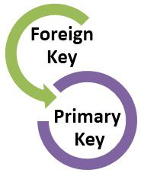
Foreign key:
Foreign keys are the attributes (columns) of a table that points to the primary key of another table.
They act as a cross-reference between tables.
r1,r2 ← relations
A relation r1 can have an attribute which will be the primary key of another relation r2
This attribute is known as foreign key from r1 referencing r2
r1 – referencing relation
r2- referenced relation

Slide 28
Foreign key
Department
Employee
DeptCode | DeptName
001 | Science
002 | English
005 | Computer
Teacher ID | Fname | Lname
B002 | David | Warner
B017 | Sara | Joseph
B009 | Mike | Brunton
Referenced Relation
Employee
Teacher ID | Fname | Lname | DeptCode
B002 | David | Warner | 001
B017 | Sara | Joseph | 002
B009 | Mike | Brunton | 005
Referencing Relation

Slide 29
Referential Integrity
Referential integrity refers to the accuracy and consistency of data within a relationship.
In relationships, data is linked between two or more tables. (FK,PK)
Need to ensure that data on both sides of the relationship remain intact.
So, referential integrity requires that, whenever a foreign key value is used it must reference a valid, existing primary key in the parent table.

Slide 30
Referential Integrity
Department
DeptCode | DeptName
001 | Science
002 | English
005 | Computer
Delete
Referenced Relation
Employee
Referencing Relation
Teacher ID | Fname | Lname | DeptCode
B002 | Chris | Evans | 001
B017 | Scarlet | Johansson | 002
B009 | Mark | Rufallo | 005
B010 | Robert | Downy | 008

Slide 31
Referential Integrity
So referential integrity will prevent users from:
Adding records to a related table if there is no associated record in the primary table.
Changing values in a primary table that result in orphaned records in a related table.
Deleting records from a primary table if there are matching related records.
Primary Key Constraint
No column that is part of the primary key can contain a null.
A table can have only one primary key
Foreign Key Constraint
constraint prevents any actions that would destroy link between tables with the corresponding data values

Slide 32
Integrity Constraints
Integrity constraints are a set of rules. It is used to maintain the quality of information.
Integrity constraints ensure that the data insertion, updating, and other processes have to be performed in such a way that data integrity is not affected.
Used to guard against accidental damage to the database.
Domain constraints
Entity integrity constraints
Referential Integrity Constraints
Key constraints

Slide 33
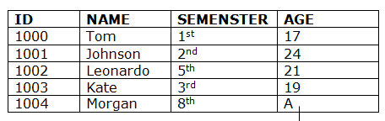
Domain Constraints
Domain constraints can be defined as the definition of a valid set of values for an attribute.
The data type of domain includes string, character, integer, time, date, currency, etc. The value of the attribute must be available in the corresponding domain.

Slide 34
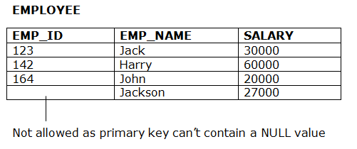
Entity Integrity Constraints
The entity integrity constraint states that primary key value can't be null.
This is because the primary key value is used to identify individual rows in relation and if the primary key has a null value, then we can't identify those rows.
A table can contain a null value other than the primary key field.

Slide 35
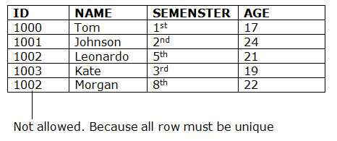
Key Constraints
Keys are the entity set that is used to identify an entity within its entity set uniquely.
An entity set can have multiple keys, but out of which one key will be the primary key. A primary key can contain a unique value in the relational table.

Slide 36
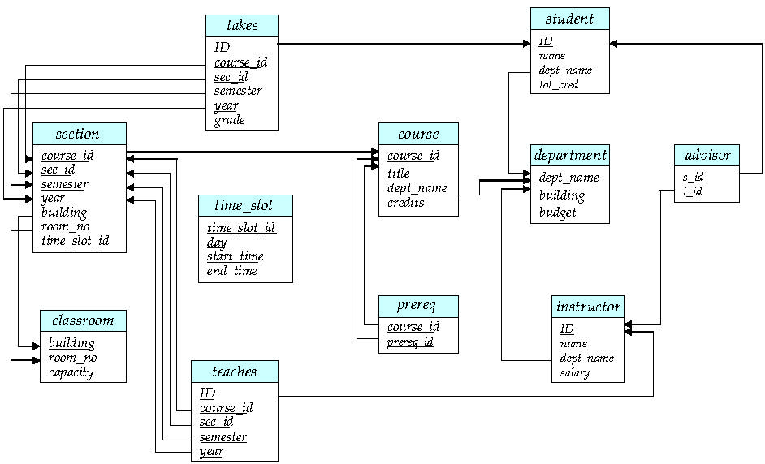
Schema Diagram for University Database
A database schema, along with primary key and foreign key dependencies, can be depicted by schema diagrams

Slide 37
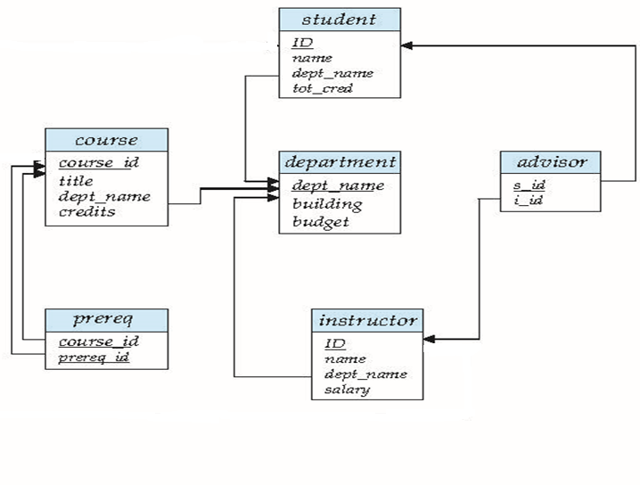
Schema Diagram for University Database
READ and REFER..
1.6.2 Database Design for a University Organization [ Page NO: 16]
2.2 Database Schema [ Page NO: 42- 47]

Slide 38
Summary
Relational Model
Schema
Degree, Cardinality
Attributes Types
Keys
Super Key
Candidate Key
Primary Key
Constraints

Slide 39
ACTIVITY
Video Courtesy
Cambridge GCSE Computing Online
Worksheet 1

Slide 40
Quiz 1: CSE A,B
Q1
A database which consists of more than one linked table is called a...
BTL1
flat file database
relational database
linked database
validated database

Slide 41
Quiz 1
Q1
A database which consists of more than one linked table is called a...
BTL1
flat file database
relational database
linked database
validated database
Relational database

Slide 42
Quiz 1 CSE A,B
Q2
In a database table, the field which is identified as being a unique identifier for each record is called the... BTL1

Slide 43
Quiz 1
Q2
In a database table, the field which is identified as being a unique identifier for each record is called the... BTL1
Primary Key

Slide 44
Quiz 1 CSE A,B
Q3
Fill in the blanks and give proper label BTL2
Degree=
Cardinality=
2
1
Employee
Teacher ID | Fname | Lname
B002 | David | Warner
B017 | Sara | Joseph
B009 | Mike | Brunton
4
3
5
6

Slide 45
Quiz 1
Q3
Fill in the blanks and give proper label BTL1
Degree=
Cardinality=
Attributes
Relation
Employee
Teacher ID | Fname | Lname
B002 | David | Warner
B017 | Sara | Joseph
B009 | Mike | Brunton
B008 | Nathan | Kurtz
Primary Key
Tuples
3
4

Slide 46
Quiz 1
Q4
In a school database there are two tables. Which two fields could be used to link the two tables.
BTL2
STUDENT
Student_Admission_Number
Surname
First_Name
Date_of_Birth
Year_Group
SUBJECT
Subject_ID
Subject_Name
Grade
Student_Admission_Number
Test_Result

Slide 47
Quiz 1
Q4
In a school database there are two tables. Which two fields could be used to link the two tables.
BTL2
Student_Admission_Number in STUDENT table and
Student_Admission_Number in SUBJECT table
STUDENT
Student_Admission_Number
Surname
First_Name
Date_of_Birth
Year_Group
SUBJECT
Subject_ID
Subject_Name
Grade
Student_Admission_Number
Test_Result

Slide 48
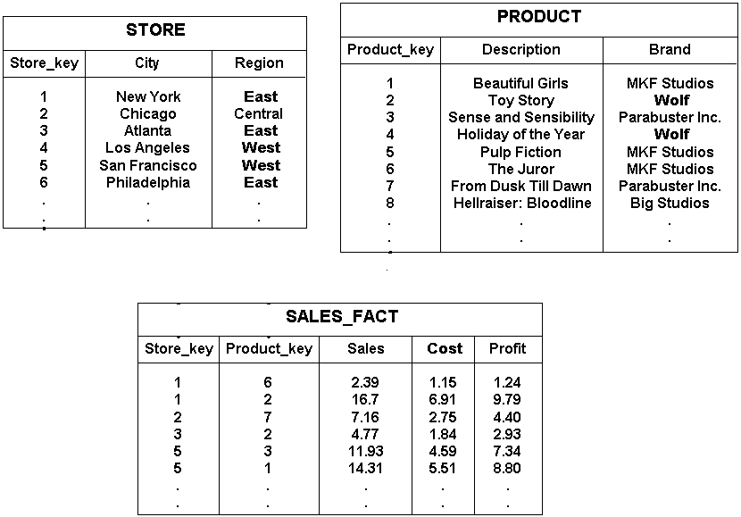
Quiz 1
BTL2
Q5
Identify Primary Key, Foreign Key , Referencing Relation and Referenced Relation for the following relations

Slide 49
Quiz 1
BTL2
Q5
Identify Primary Key, Foreign Key , Referencing Relation and Referenced Relation for the following relations

Slide 50
THANK YOU

